Slide 1
Node js
Day 3
shimaa ismail

Slide 2
content
Middleware
Mongoose
mvc
Project structure

Slide 3
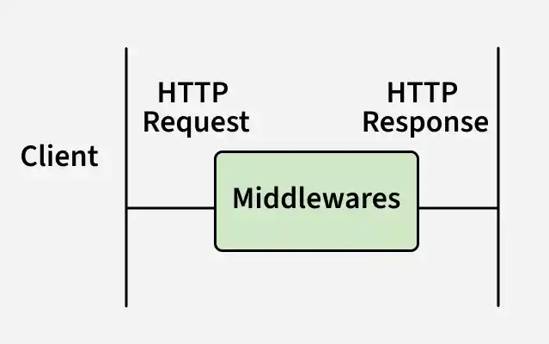
Middleware
Middleware in Express.js are functions that run during the request–response lifecycle

Slide 4
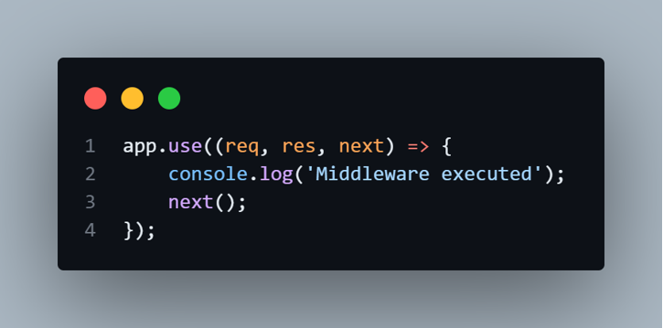
Types of Middleware
1. Application-level Middleware
2. Router-level Middleware
3. Error-handling Middleware
4. Built-in Middleware
5. Third-party Middleware
Middleware functions can perform the following tasks:
Execute any code.
Can read or modify req and res.
May send a response and end the cycle.
Uses next() to pass control to the next middleware.

Slide 5
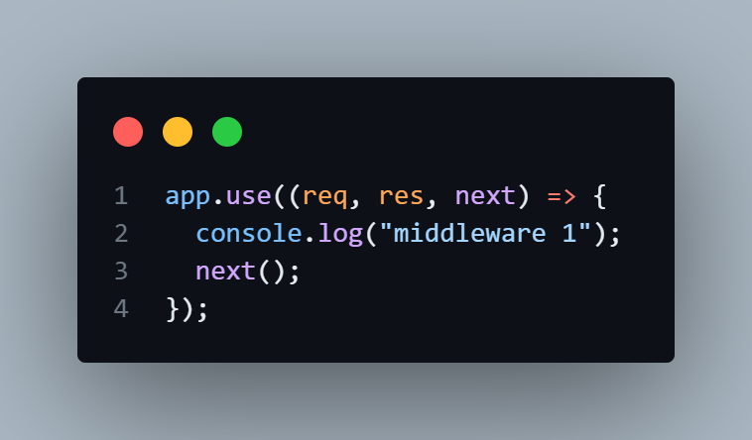
Application-level Middleware
is bound to an instance of the app object using app.use() or app.METHOD() (like app.get(), app.post(), etc.).
app.use() applies middleware on a specified path. If no path is given, it runs for every request to the application.

Slide 6
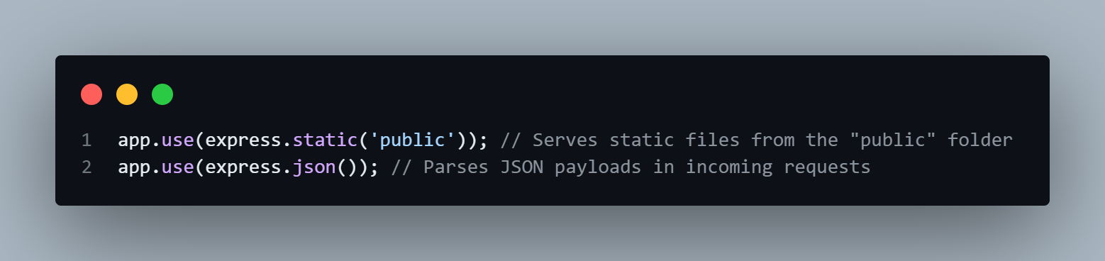
Built-in Middleware
Express has the following built-in middleware functions:
express.static serves static assets such as HTML files, images, and so on.
express.json parses incoming requests with JSON payloads.

Slide 7
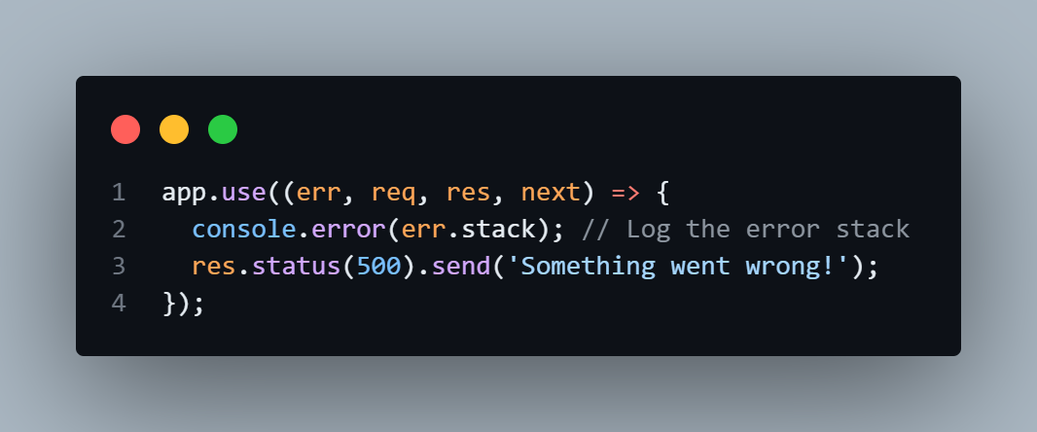
Error-handling Middleware
Error-handling middleware always takes four arguments
should be at the end of all routes and middleware

Slide 8
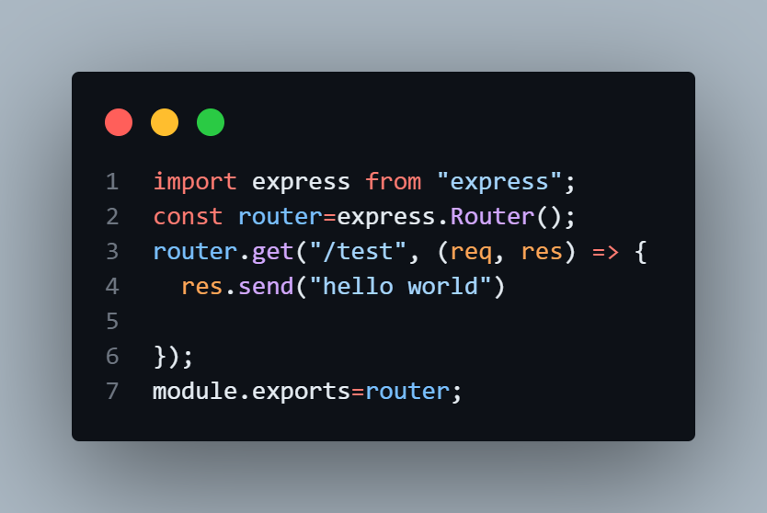
Router-level Middleware
Instead of putting all routes in one file , split them into separate files

Slide 9
Mongoose
is a popular ODM (Object Data Modeling) library for MongoDB
Schema Definition – Define the structure of documents (fields, types, validation rules) in a clear, declarative way.
Model Layer –wrapper for a MongoDB collection, used for CRUD
Async/Await – all operations are asynchronous (promise-based)
Built-in Validation – Enforce required fields, string lengths, numeric ranges, custom validators, etc.
Middleware (Hooks) – Execute logic before/after operations (e.g., hashing passwords before saving).
Enables easy querying and data relationships

Slide 10
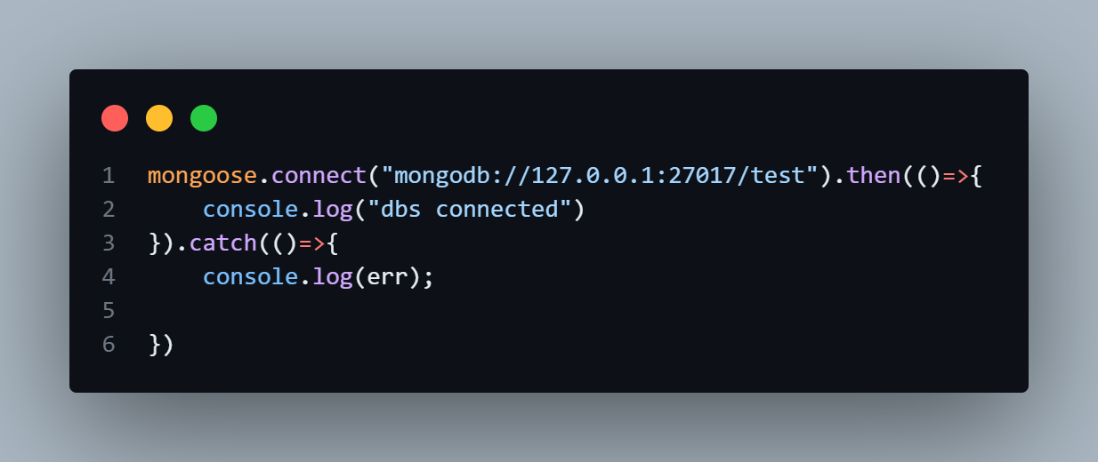
step for use mongoose
install mongoos
npm i mongoose
connect on Database
define schema
create model

Slide 11
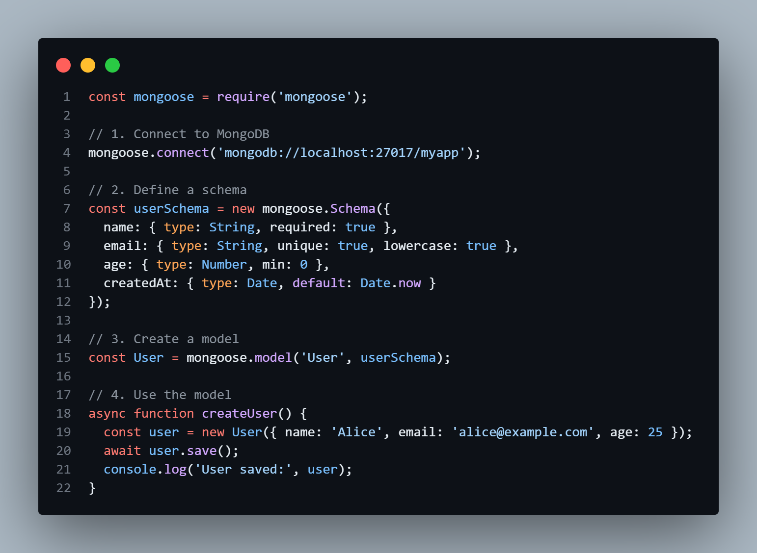
mongoose

Slide 12
CRUD operation
Operation | Methods
Create | new Model() + .save(), Model.create()
Read | find(), findOne(), findById()
Update | updateOne(), updateMany(), findOneAndUpdate(),
 | findByIdAndUpdate()
Delete | deleteOne(), deleteMany(), findOneAndDelete(), findByIdAndDelete()

Slide 13
MVC
is an architectural/design pattern that separates an application into three main logical components Model, View, and Controller
Model | View | Controller
Handles data & logic. Defines schemas | Handles the presentation layer (UI). | Receives the request from routes Processes logic Interacts with the Model Sends back a response

Slide 14
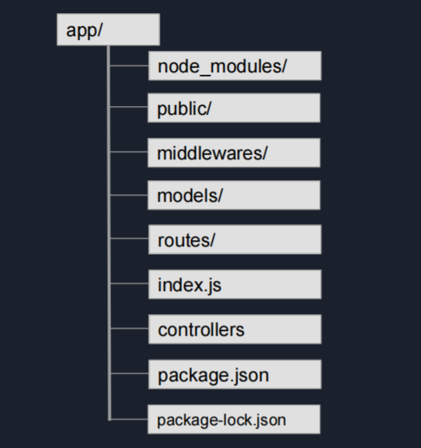
Project Structure

Slide 15
THANK YOU

